Slide 1
EDA OF CRYPTOCURRENCY AND STOCKS
Submitted in the partial fulfillment for the award of the degree of
BACHELOR OF ENGINEERING
IN
CSE BIG DATA ANALYTICS
Submitted by: Under the Supervision of:
Abhishek Rana(20BCS3818) Dr. Rahul Rastogi
Tanish Vermani(20BCS3815)
Department of AIT-CSE
DISCOVER . LEARN . EMPOWER

Slide 2
Outline
OUTLINE
Introduction to Project
Problem Formulation
Objectives of the work
Methodology used
Results and Outputs
Conclusion
Future Scope
References

Slide 3
INTRODUCTION
Our Project “EDA OF CRYPTOCURRENCIES & STOCKS” is a Web Application which can do price prediction and give detailed overviews of cryptocurrencies and stocks.
Exploratory data analysis (EDA) is used by data scientists to analyze and investigate data sets and summarize their main characteristics, often employing data visualization methods.
purpose of our project things easier for the investors whether beginners or experts by providing them an interface where they can get all the important things about any specific crypto and stocks before investing, so they can invest wisely and profitably.

Slide 4

Problem Formulation
In Today’s world Stocks & Cryptocurrencies markets have grown a lot and each day more and more people are being pulled towards in these markets. Perhaps the most common reason why people invest in cryptocurrency is to speculate on the price in the hope the asset will be worth more in the future.
In our Web Application we show detailed prices and mainly the future prediction of cryptos and stocks using regression model showing their time series data and forecast data.

Slide 5
Objectives of the Work
This project aims to help the young and expert investors to have a new aspect regarding investment in cryptocurrencies and stocks with the help of data science using regression and prediction model.
The main purpose of our project is to make things easier for the investors whether beginners or experts by providing them an interface where they can get all the important things about any specific crypto and stocks before investing, so they can invest wisely and profitably.

Slide 6
Methodology used
The following methodology will be followed to achieve the objectives defined for proposed research work:
Detailed study of how a live website works and the requirements to create
one will be done.
Installation and hand on experience on existing approaches of a website will
be done. Relative pros and cons will be identified.
Various parameters will be identified to evaluate the proposed system.
Comparison of new implemented approach with exiting approaches will be
done

Slide 7
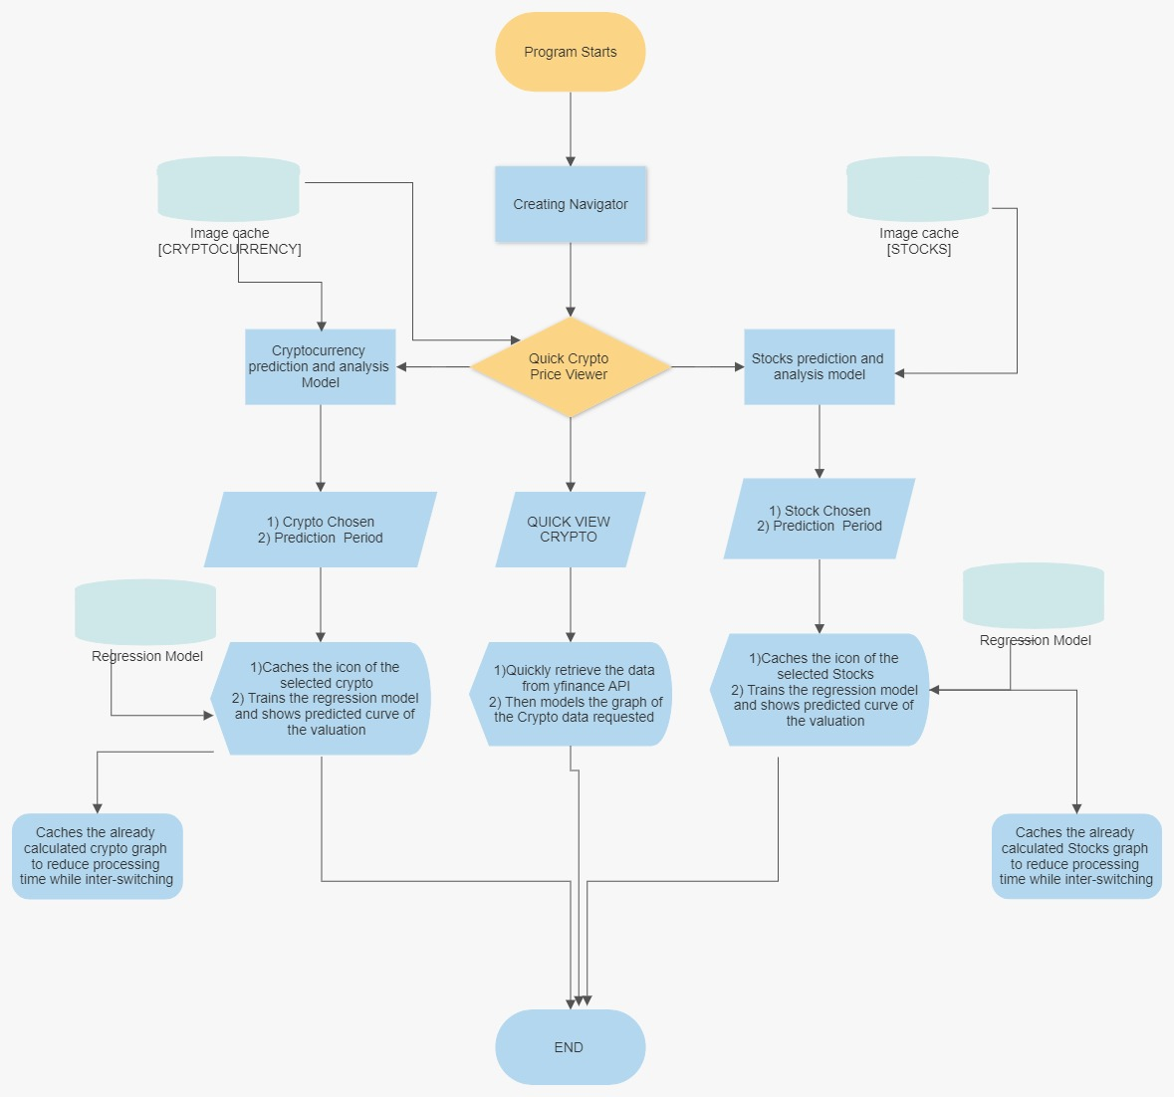
FLOWCHART

Slide 8
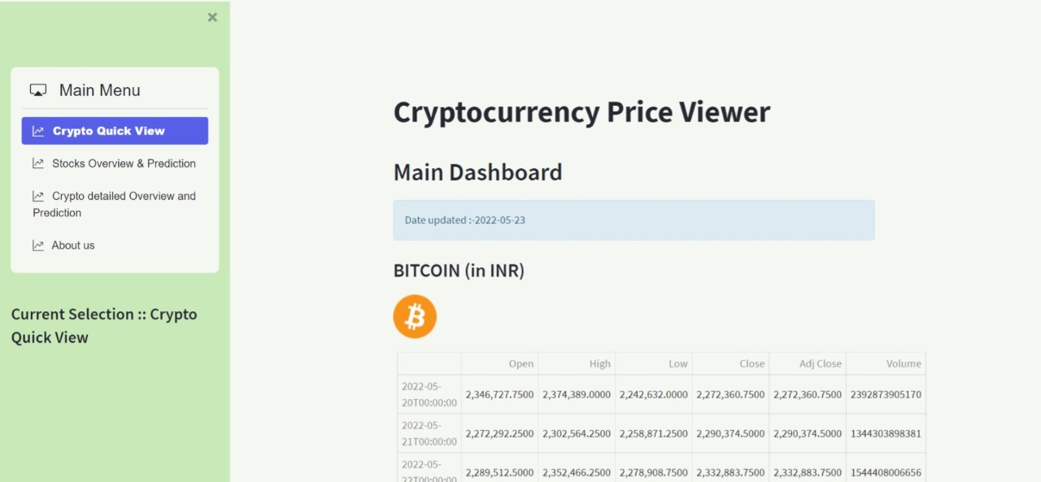
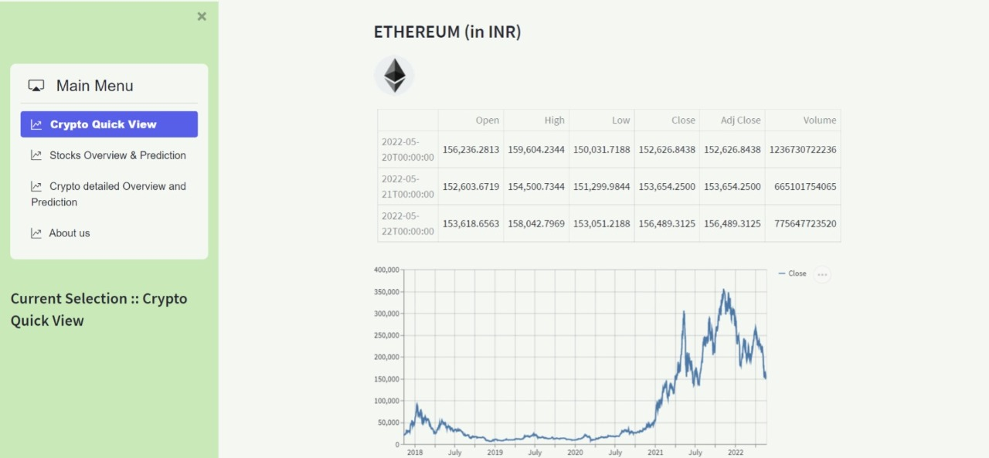
Results and Outputs

Slide 9
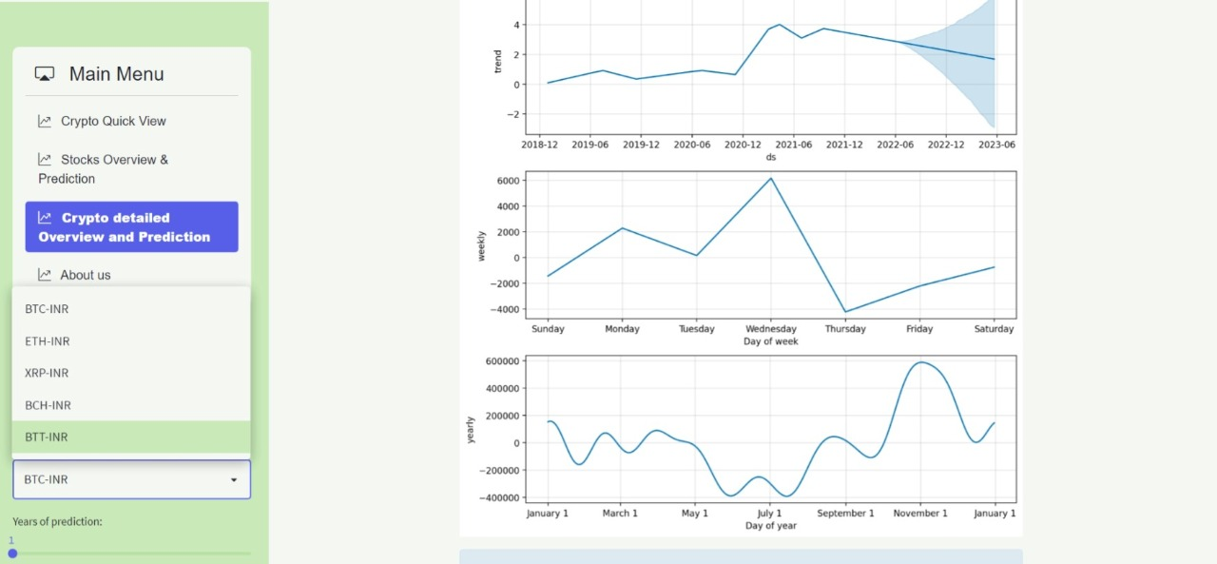
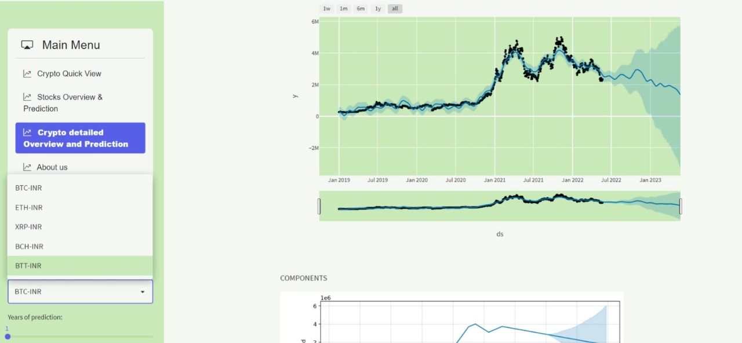

Slide 10
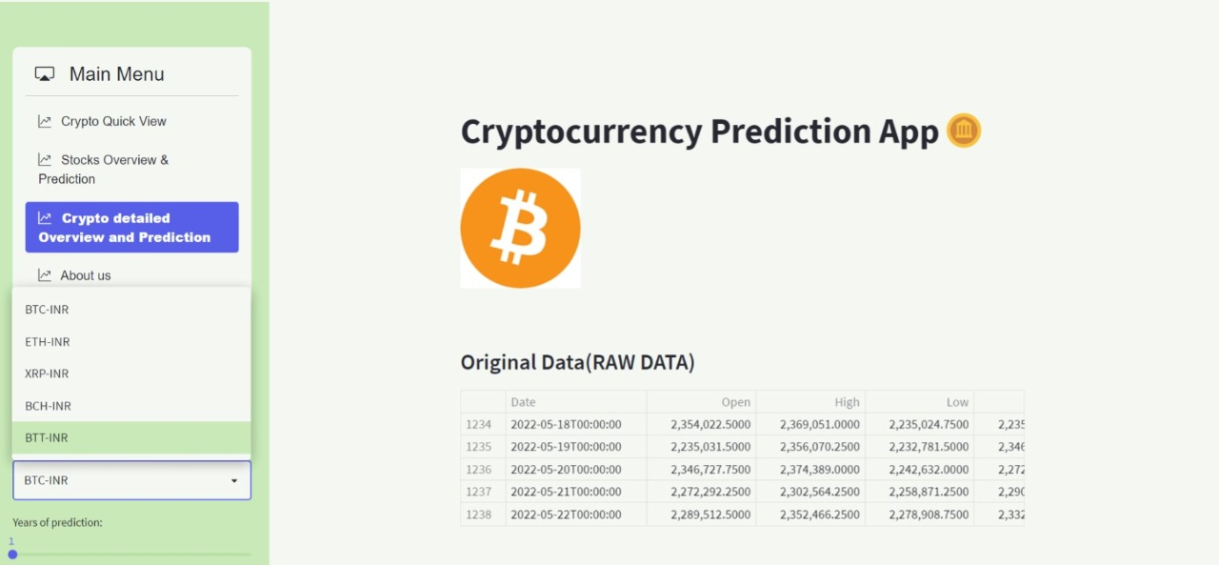
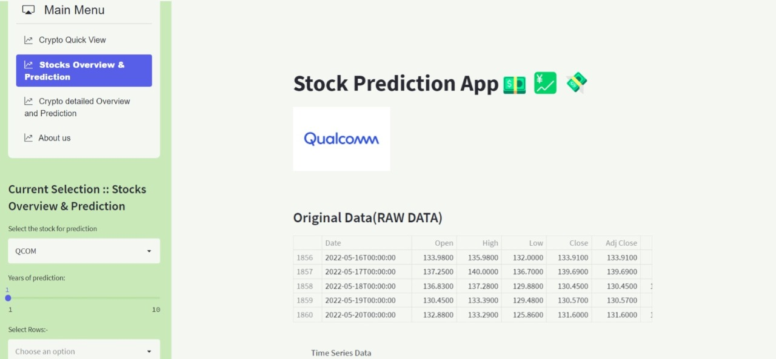

Slide 11
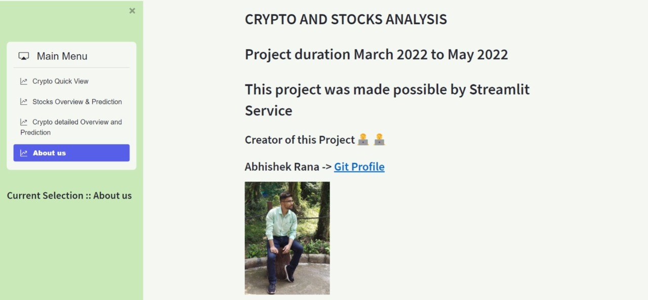
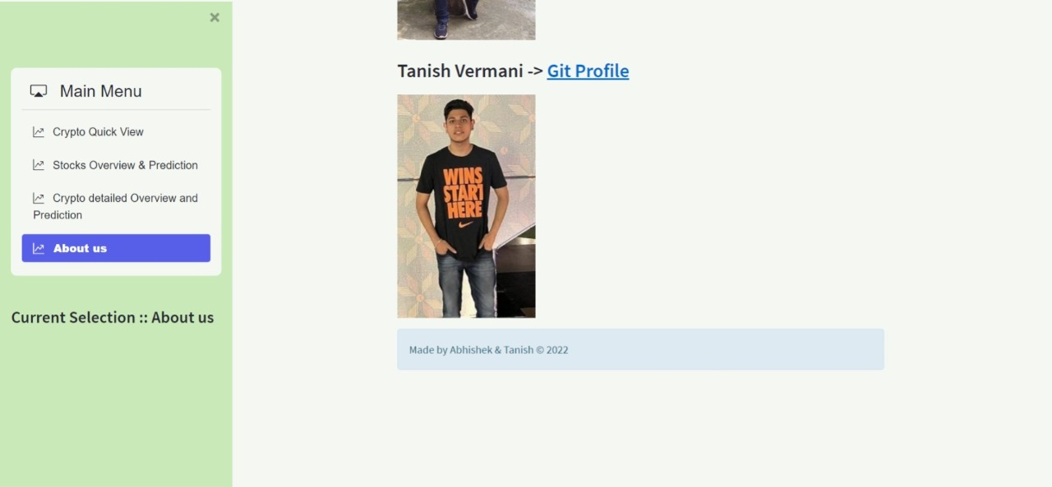

Slide 12
CONCLUSION
So this project of ours was a prototype that how with help of Data Science and APIs we can create an application which can give accurate predictions of Stocks And Cryptocurrencies.
In future we would love to make it full web application by adding more stocks and cryptos , improving the design of our application and above all make the prediction and regression analysis more accurate.

Slide 13
FUTURE SCOPE
In future we would love to make it full web application by adding more stocks and cryptos , improving the design of our application and above all make the prediction and regression analysis more accurate.
Blockchain has the potential to solve the acute issues of data storage and security, transactions processing and intermediaries, supply chains, intellectual property, government operations, charity, voting, and crowdfunding.

Slide 14
References
https://youtu.be/JwSS70SZdyM
https://youtu.be/fThcHGiTOeQ
https://youtu.be/JUSFaWkAASI

